Slide 1
Archiving DAB/DAB+ Feeds
Ben Cartwright-Cox
@benjojo12

Slide 2
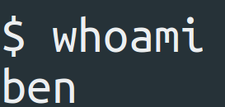
I don't do this as a job like some of you
Just a rogue archiver
"Systems" Engineer (aka software) / Ops in the day
For the most part have no idea what I am doing

Slide 3
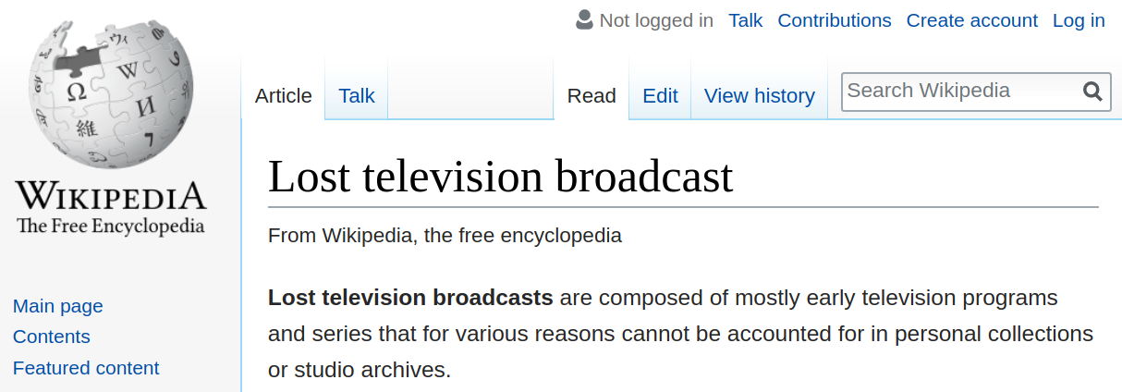

Slide 4
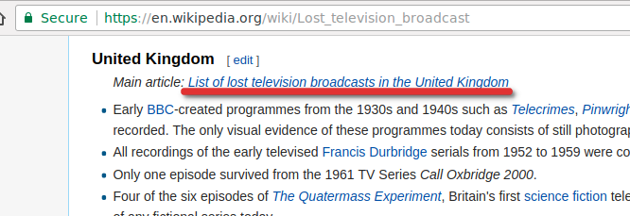

Slide 5
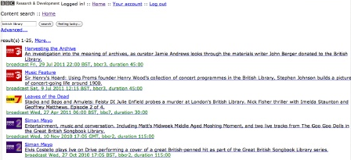
BBC Redux

Slide 7
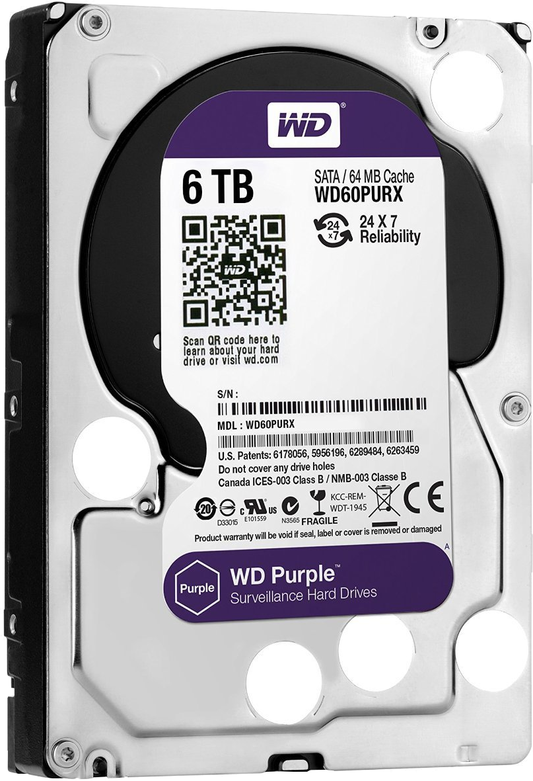
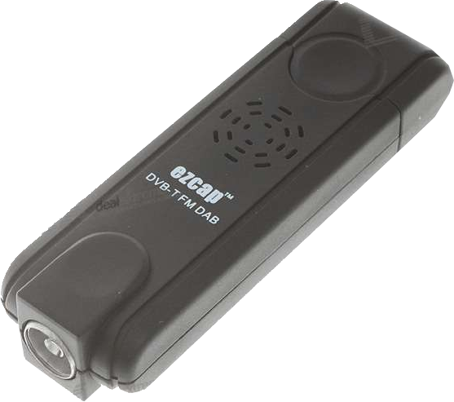

Slide 8
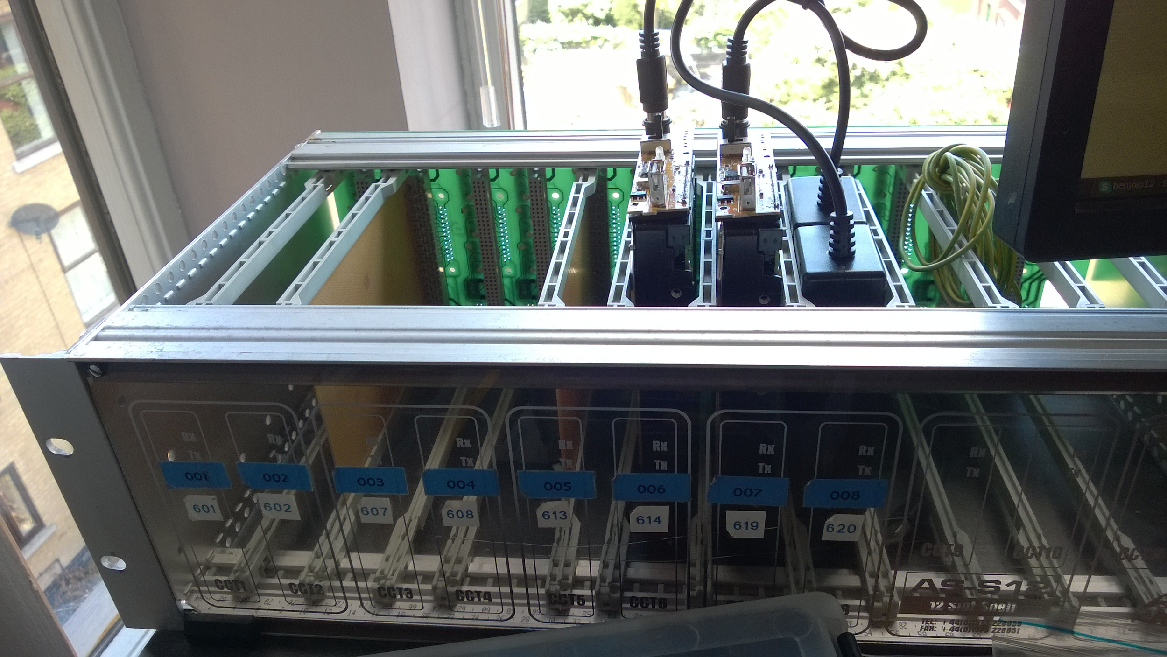

Slide 9
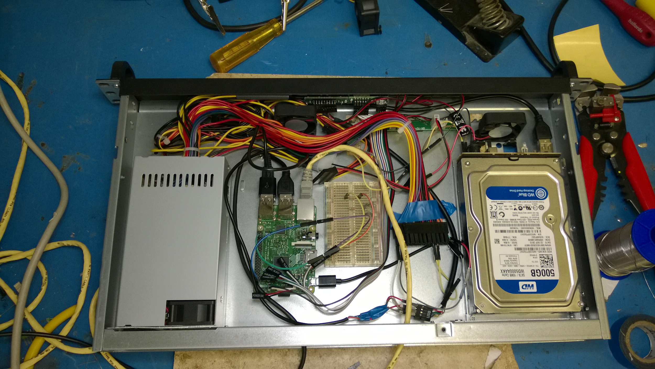

Slide 10
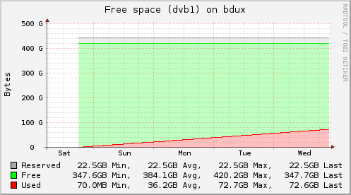

Slide 11
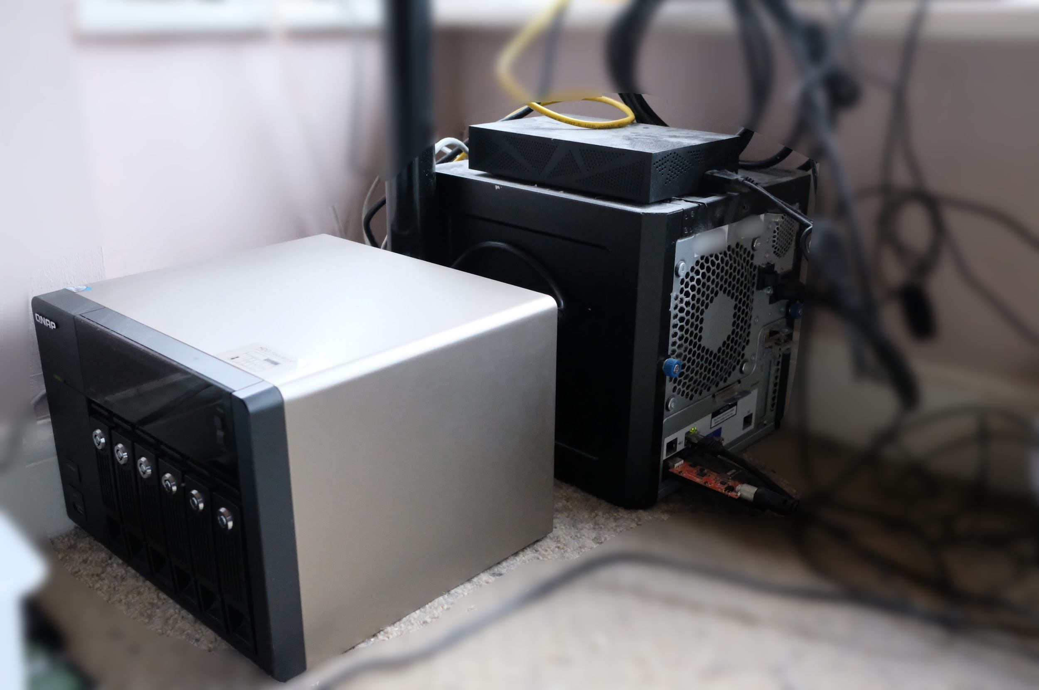
Main NAS
6TB Extra
NAS

Slide 12
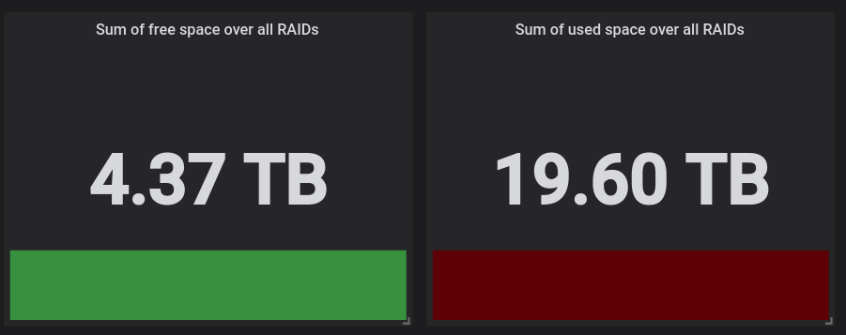
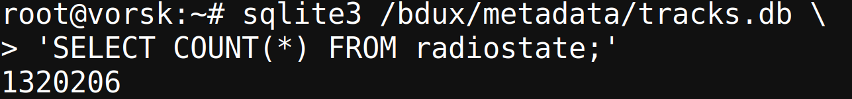
Double physical space for RAID-1

Slide 13
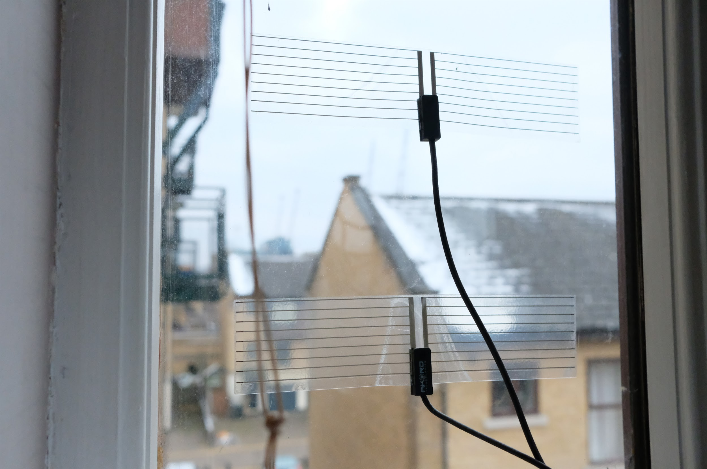

Slide 14
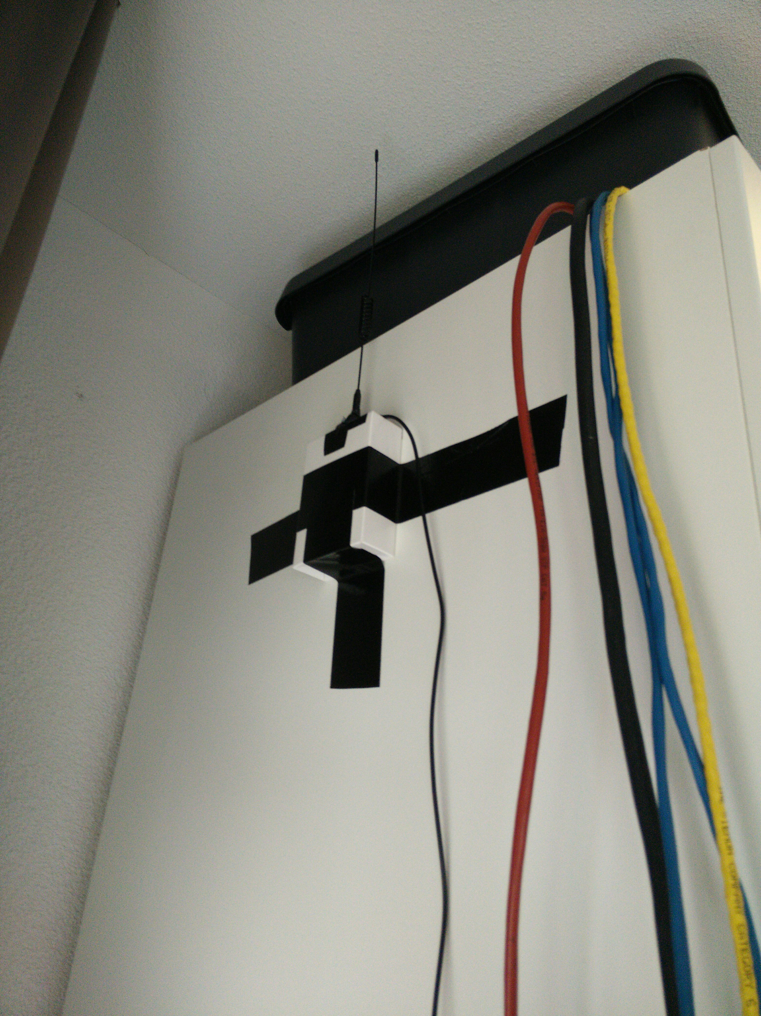
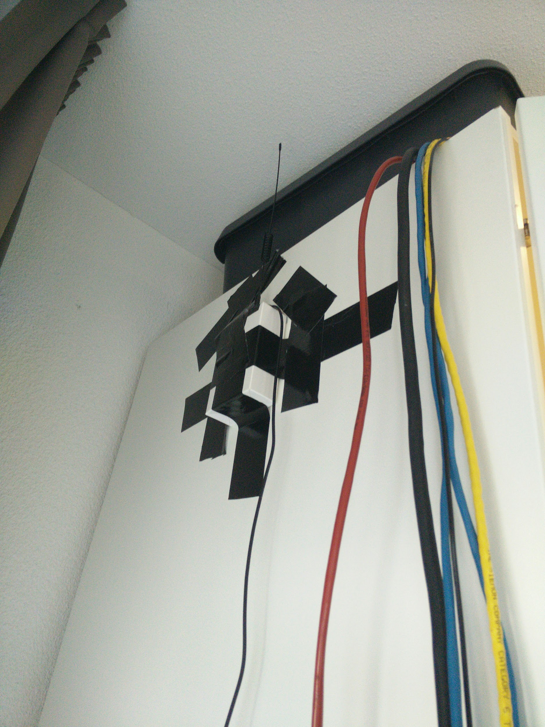
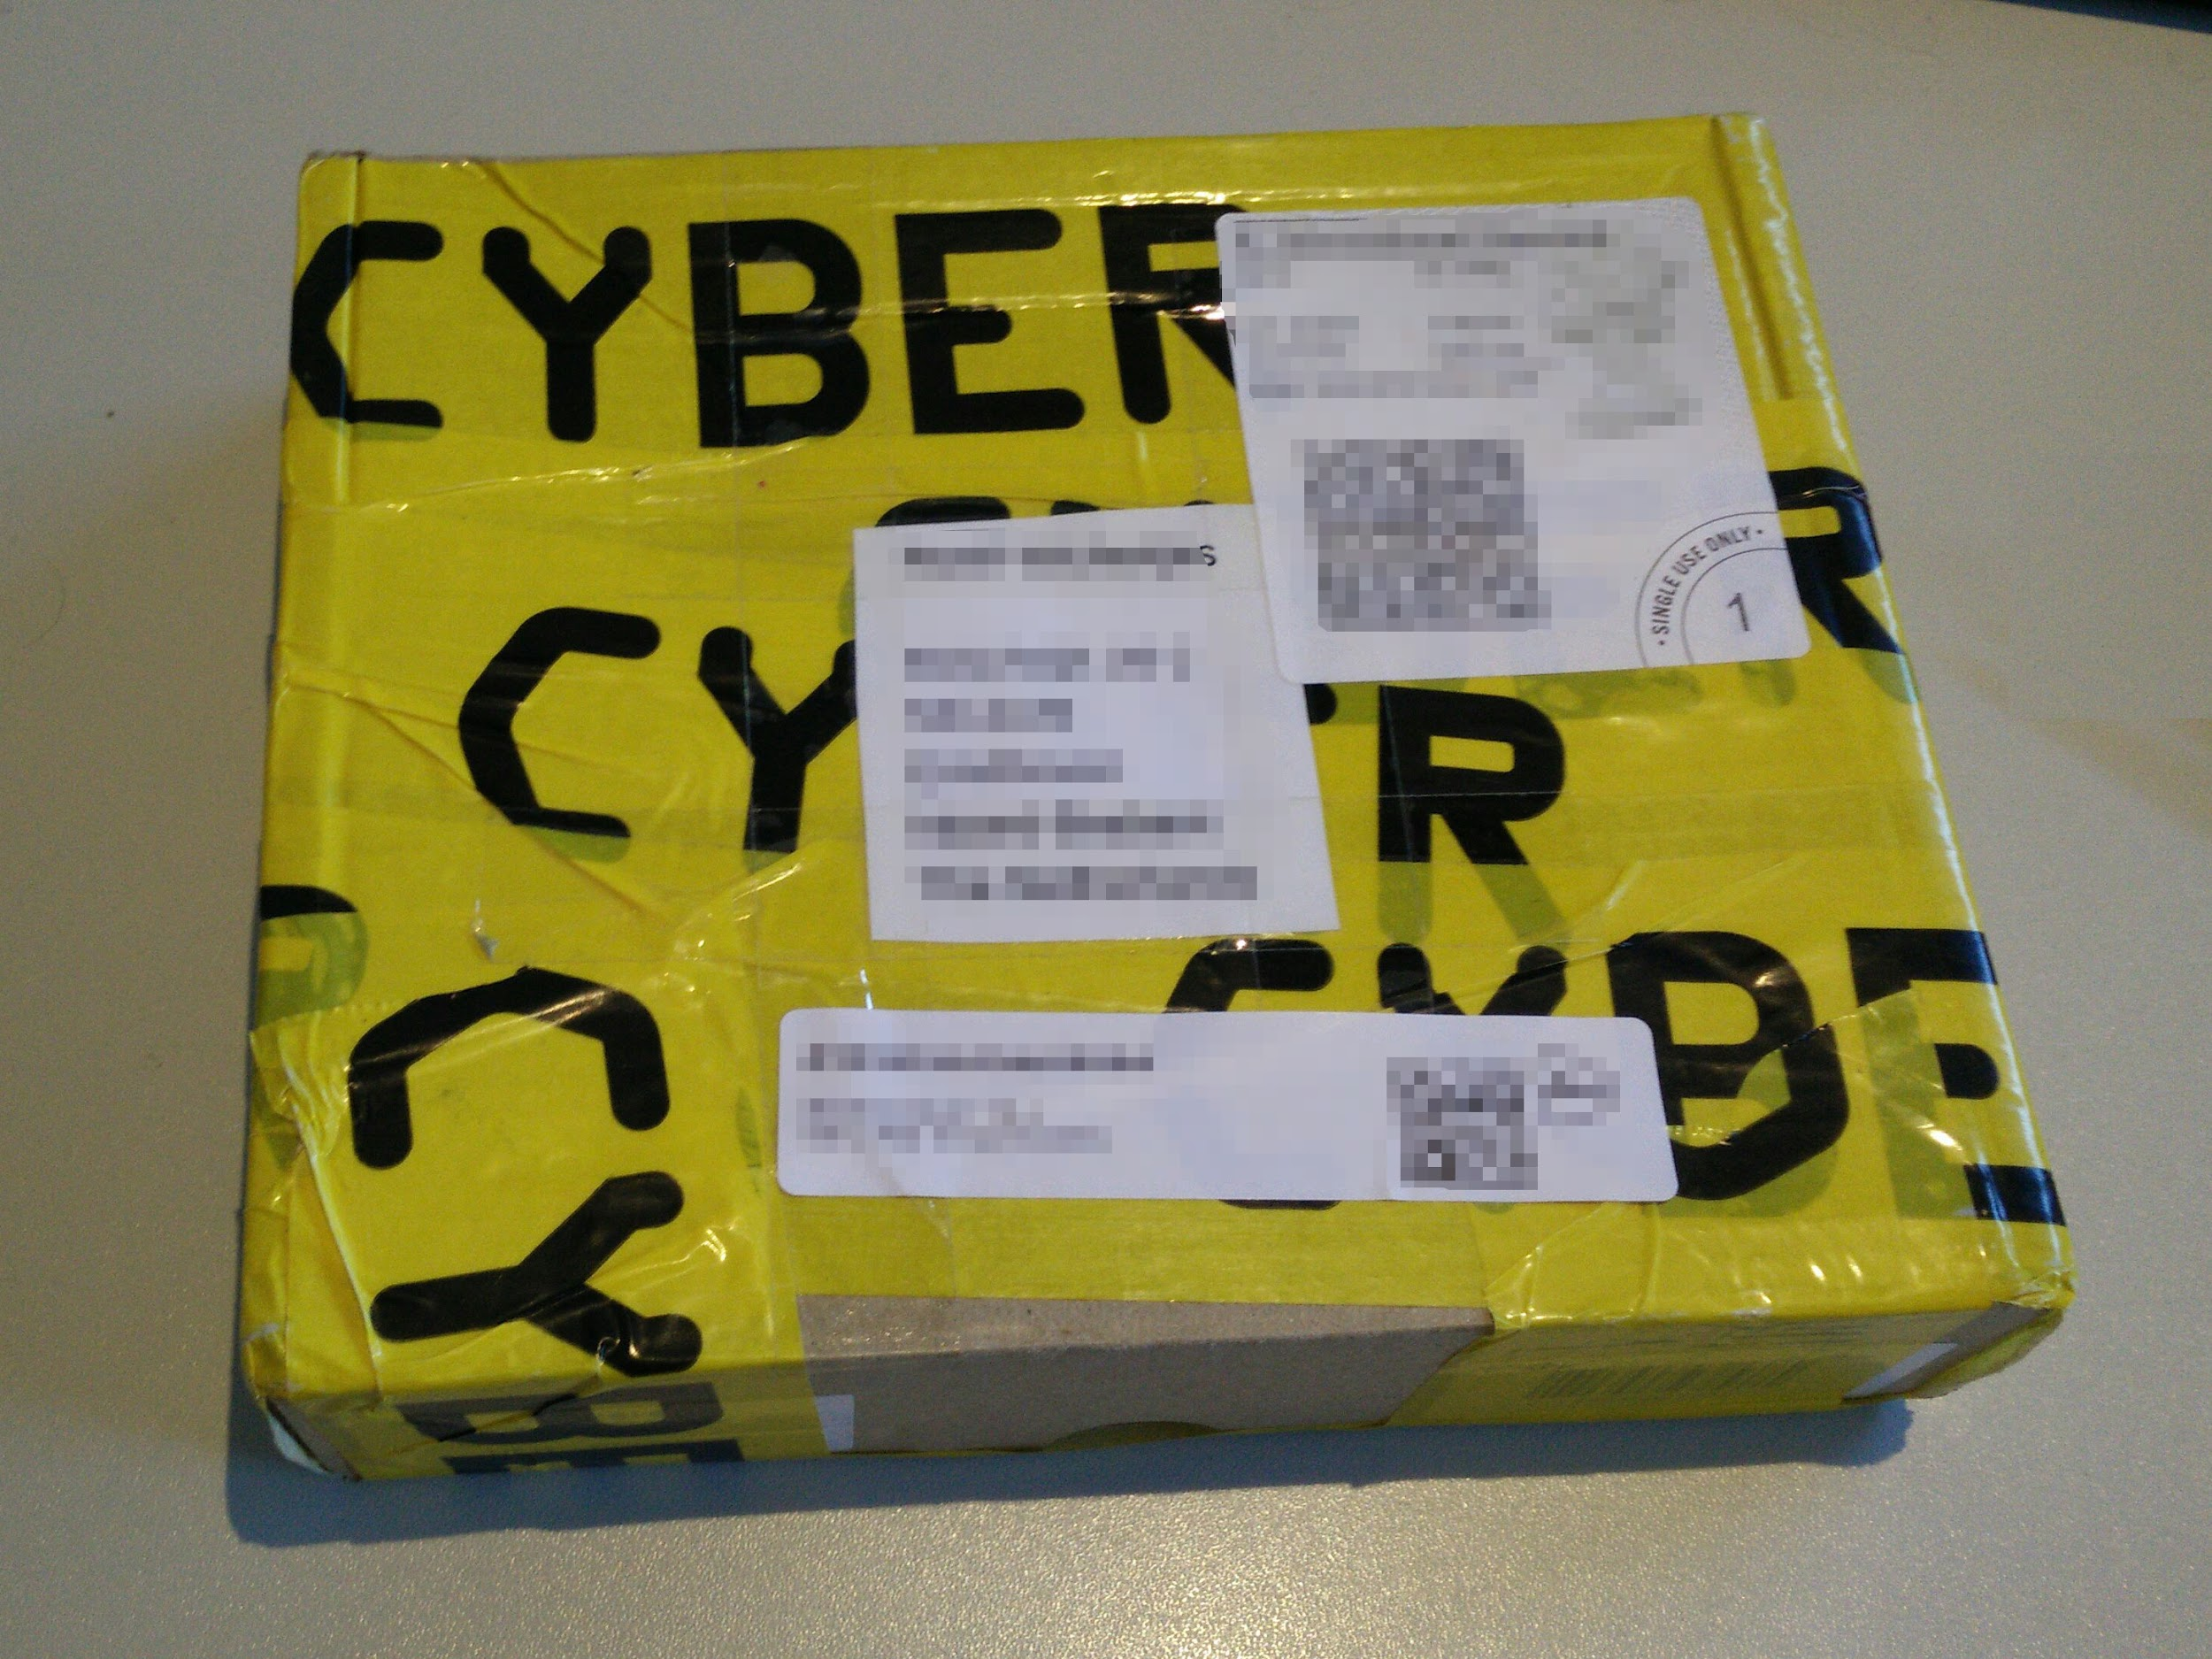



Slide 15
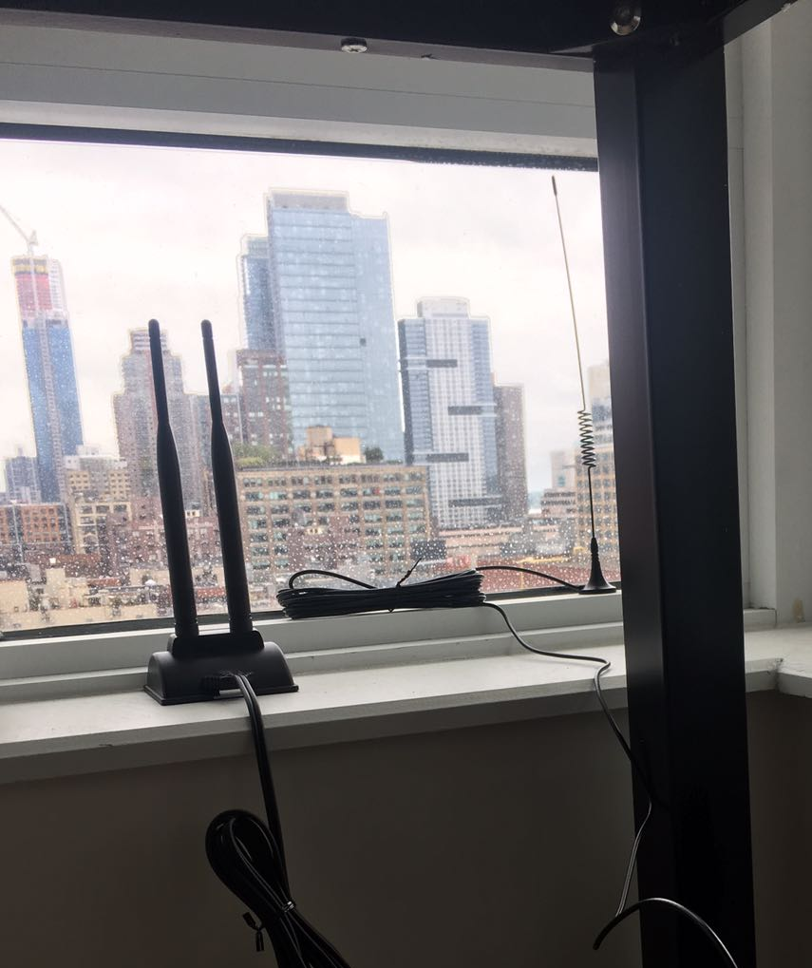

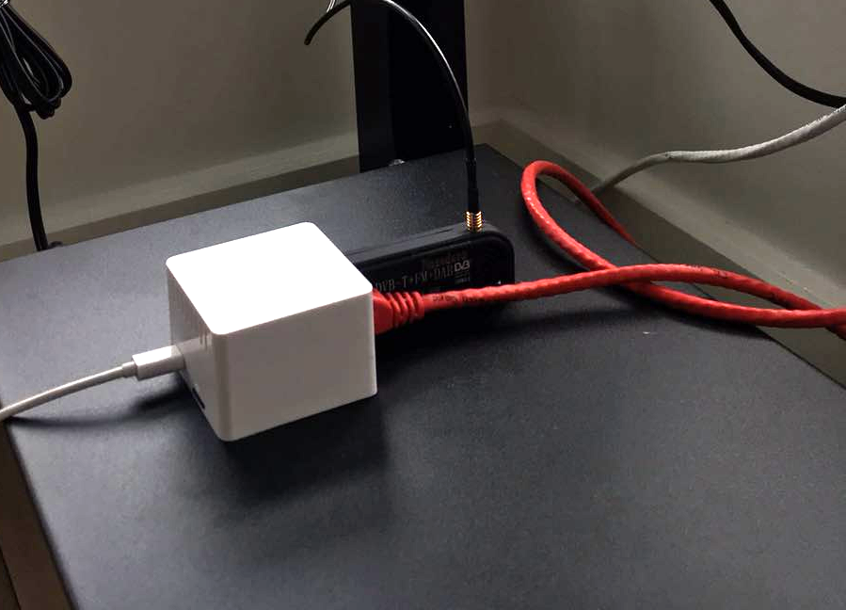


Slide 16
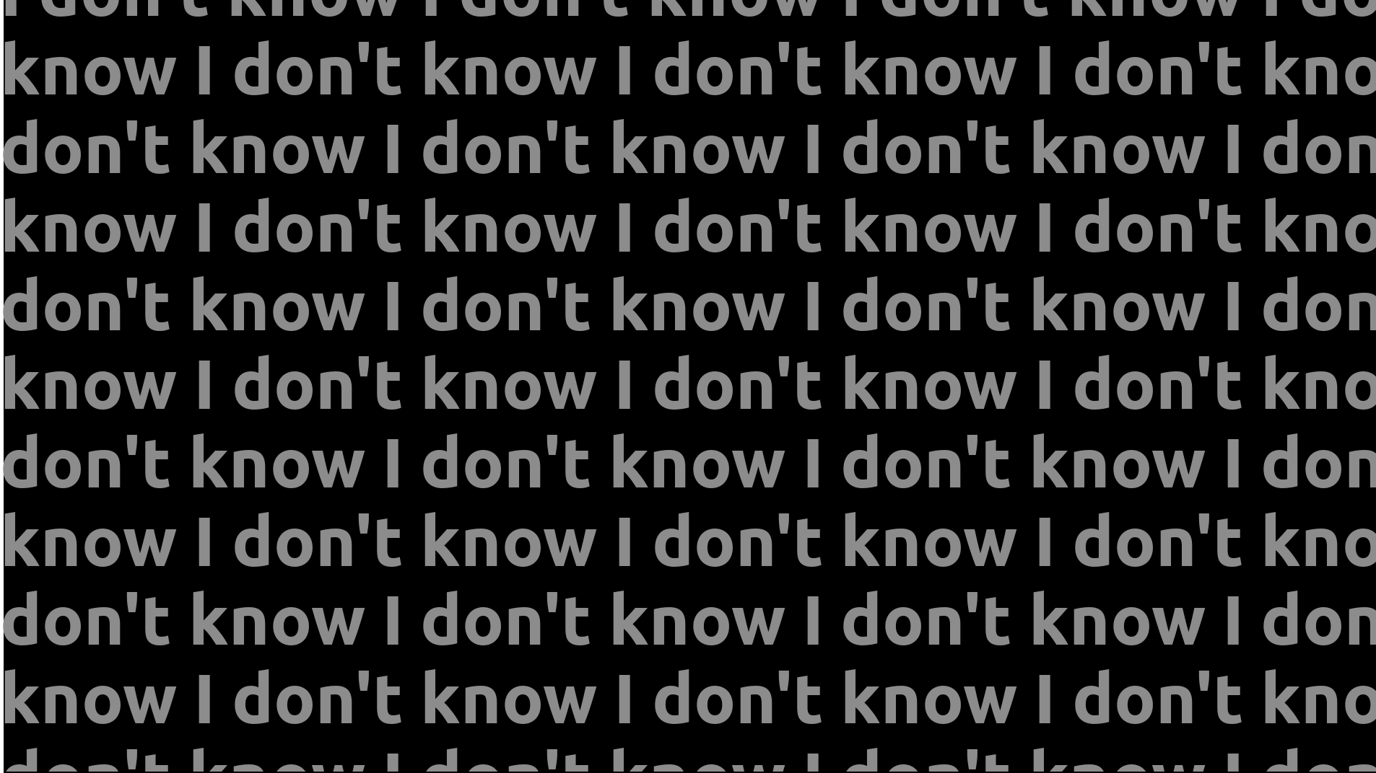



Slide 17







192 kbps MP2
80 kbps AAC
160 kbps MP2
60 kbps AAC
192 kbps MP2
64 kbps AAC
160 kbps MP2
192 kbps MP2

Slide 18
Wrap up tech overview

Slide 19
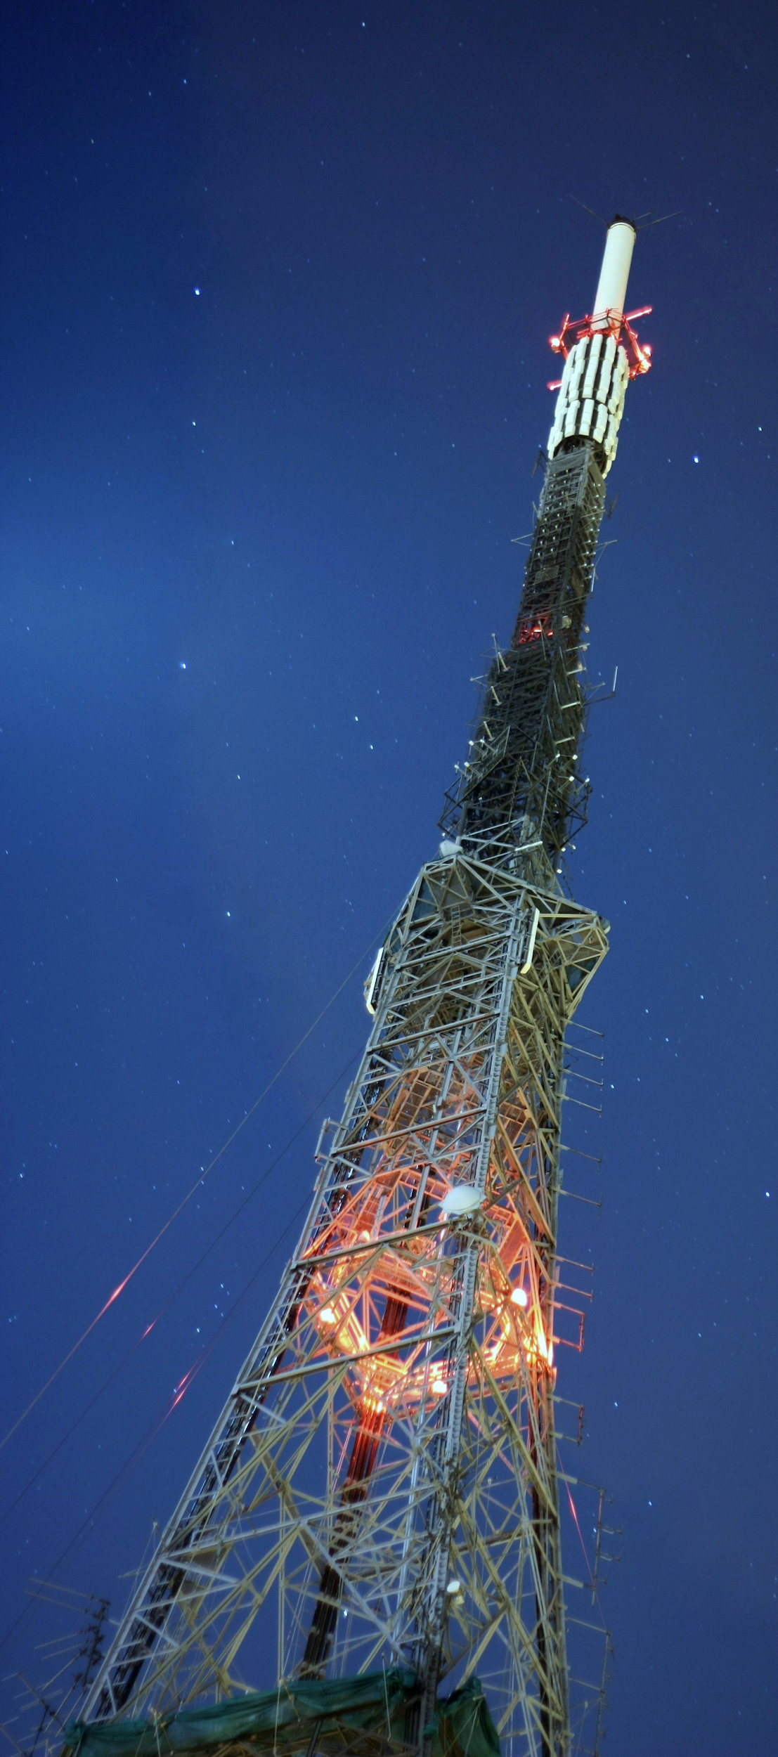
Critical Path: Recording

Slide 20
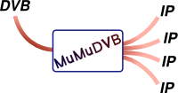
“BStreamer”
“Old content NAS”

Slide 21
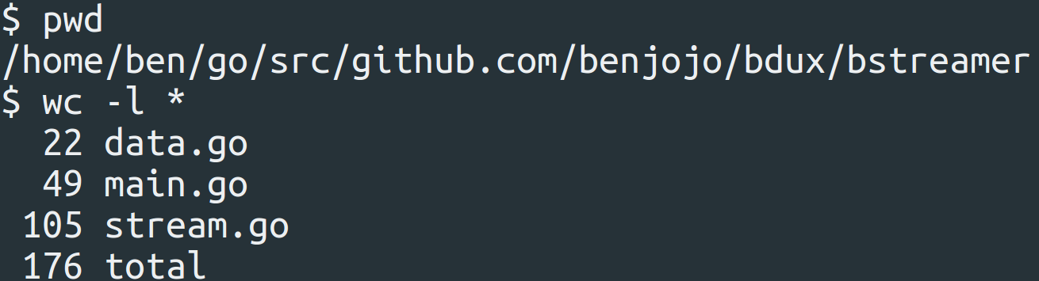
“BStreamer”

Slide 22

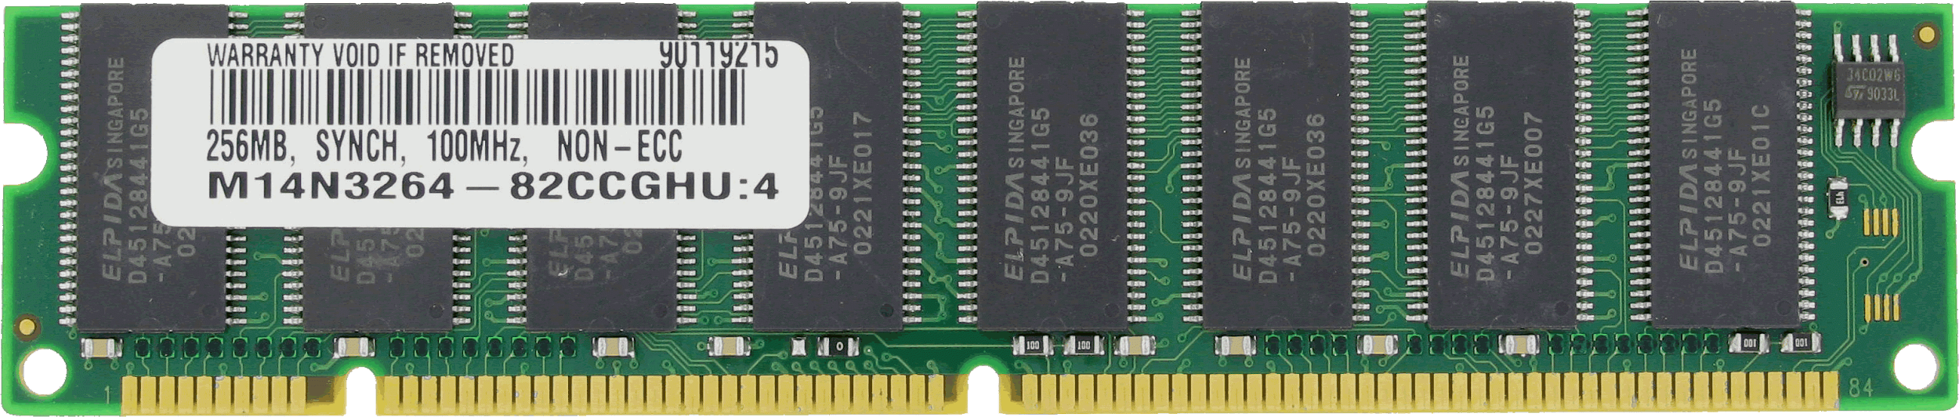
Homemade decoders for
DAB+
NRSC-5
buploader
bnetworksink

Slide 23
High Priority: Tagging

Slide 24

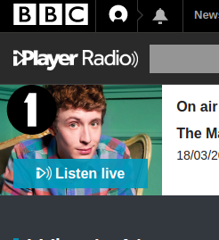
EPG Decoding
Dynamic Label Decoding
“Now playing”
Track info
Tracks.db

Slide 25
“btagger”
EPG Decoding
“Now playing”
Track info
Tracks.db

Slide 26
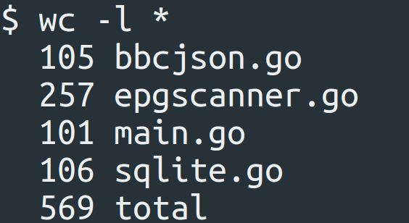
“btagger”
EPG Decoding
“Now playing”
Track info
Tracks.db

Slide 27
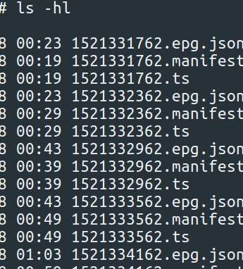
Low Priority: Playback
tracks.db

Slide 28




“bauthserver”
“audioserver”
“bfl”
User state
Rendering
API
“Real time”
tracks.db

Slide 29
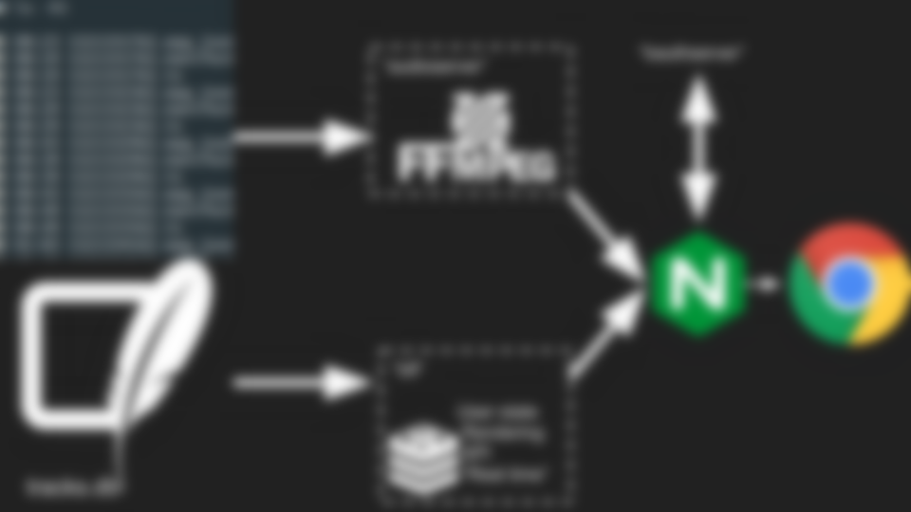
Total LOC: 80k~

Slide 30
Total LOC: 80k~
+ breaks from time to time

Slide 31
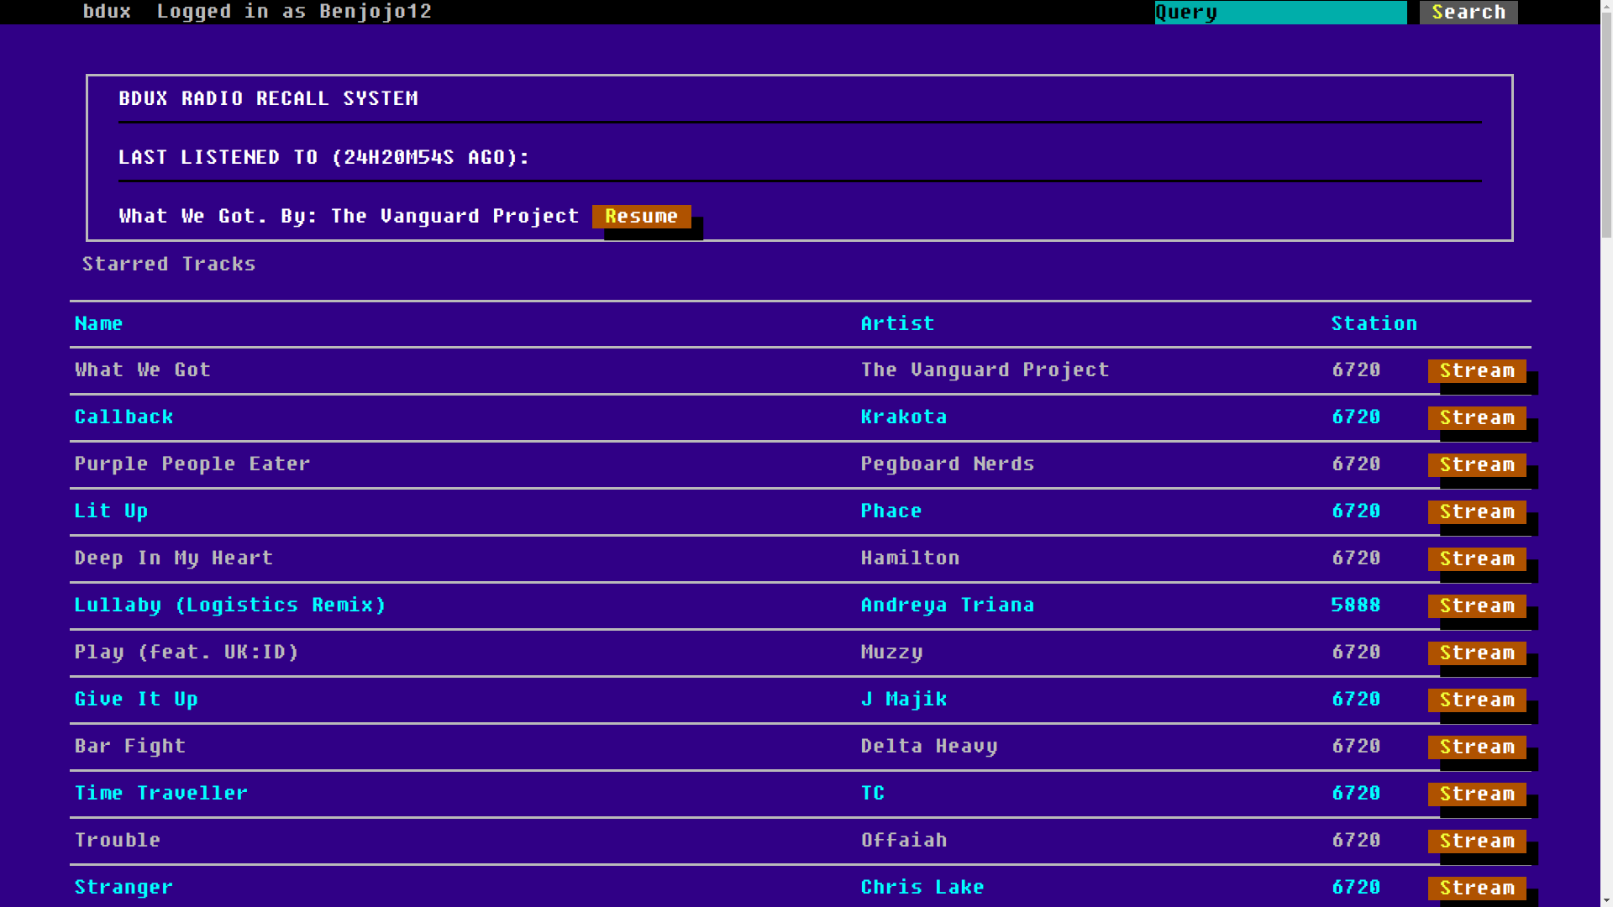

Slide 32
Data isn't always great

Slide 33
Simulcasts
+

Slide 34
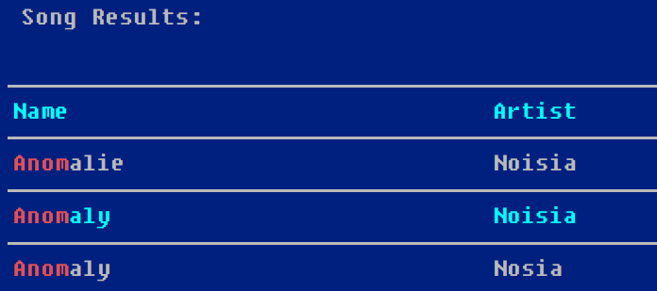
Spelling errors in track data

Slide 35
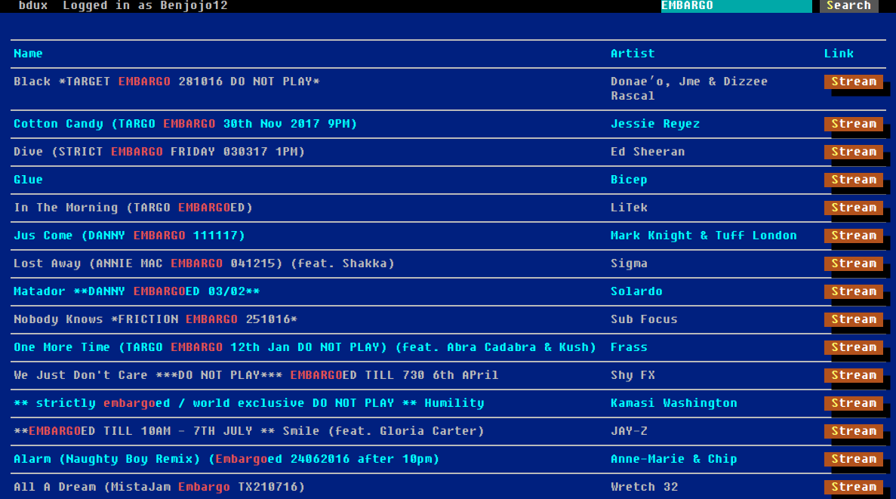
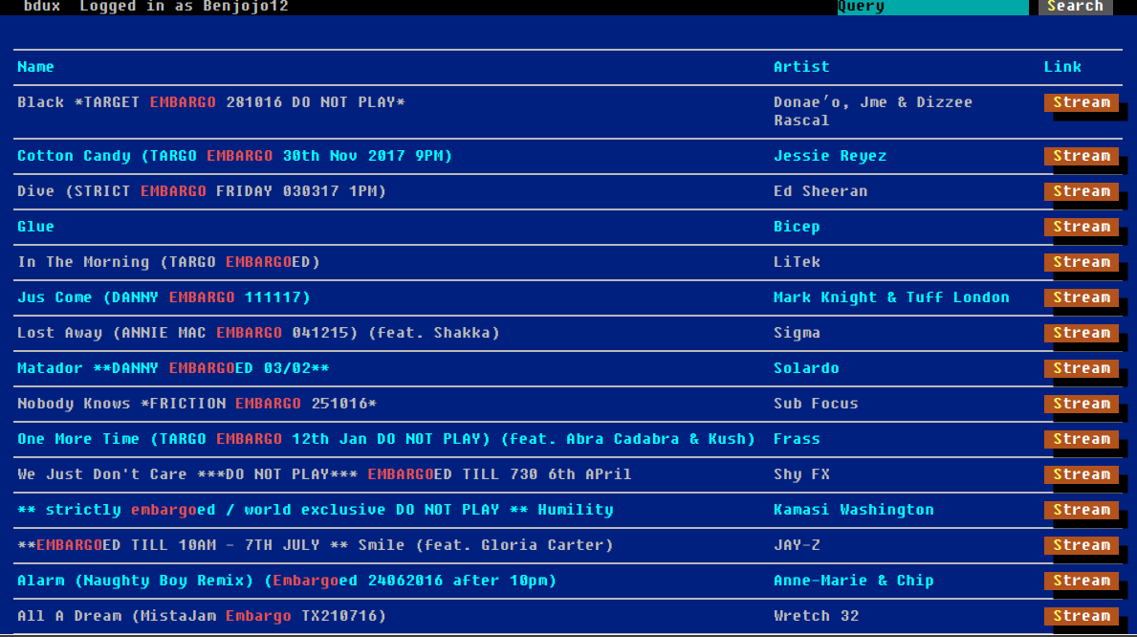

Slide 36


Slide 37
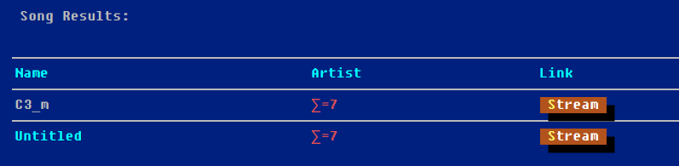

Slide 38
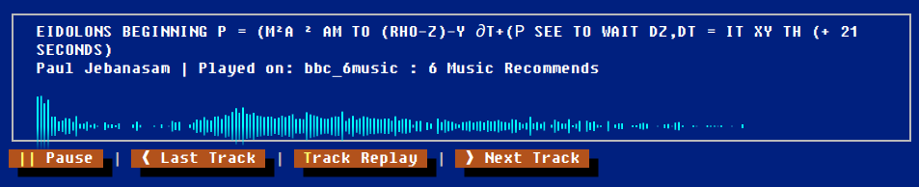

Slide 40
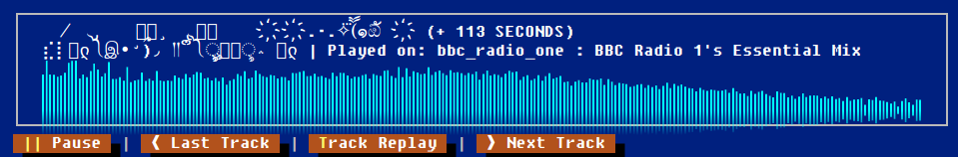

Slide 41
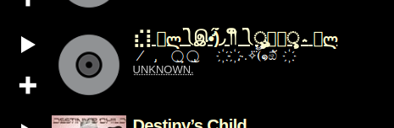

Slide 42
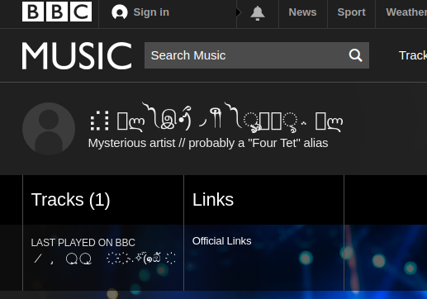

Slide 43

“Don’t mess up like Ben did”
NTP Sync All Systems
Ensure you think about failure boundaries and expectations for each µ-service you run
Run migrations as slow as you need for irreplaceable data
Keep original copies of data you are importing, you can fix your mess ups years after you make them
Don’t live in the UK where all digital radio is MPEG-2
Don’t forget about metrics
  Make sure your metrics actually connect to bad things happening

Slide 44
Questions?
Or complaints to: ben+nttw3@benjojo.co.uk

